Slide 1
Team Velocity- Sprint 1

Slide 2
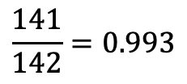

Completed/Committed Ratio- Sprint 1
$$Completed/Committed Ratio$$
$$\frac{141}{142}=0.993$$

Slide 3
Burndown Charts- Sprint 1

Slide 4
Team Velocity- Sprint 2

Slide 5
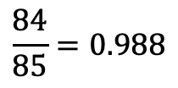
Completed/Committed Ratio- Sprint 2
$$Completed/Committed Ratio$$
$$\frac{84}{85}=0.988$$

Slide 6
Burndown Chart- Sprint 2

